Slide 1
Big Mountain Resort Presentation
Angeles Olvera

Slide 2
Problem
How can Big Mountain Resort implement a data-driven business strategy to better utilize its facilities, optimize ticket pricing, reduce cost and increase profits within the next season?
Things to consider during investigation
Theres 105 trails
Average of 350,000 visitors per season
The new chair lift added this season cost $1,540,000
Criteria for success: Increase the ticket size, but what amount is reasonable ? What will the increase be based on?
Focus on park features and park prices compared to other resorts in the country .
Features like long runs, chair lifts, vertical drop, summit elevation, base elevation and skiable terrain .
Prices like single day ticket prices and weekend ticket prices.

Slide 3
Constrains considered before investigation .
Investigation suggests we can't increase ticket price.
Customers will not be happy of price increase.
Stakeholder participants in analysis
Jimmy Blackburn - Director of Operations
Alesha Eisen - Database Manager (provided data for analysis)
Data
Single CSV file containing information from 330 resorts in the country.

Slide 4
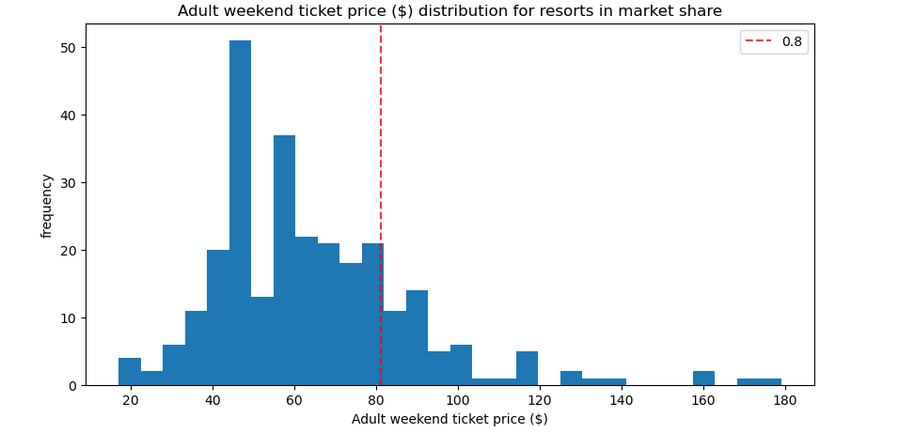
Recommendation and key findings
Big Mountain resort is not in the high end of weekend ticket prices for resorts in the country.
After analysis was completed, ticket price can increase anywhere from $87.60 to $108.32 from its original price $81.00

Slide 5
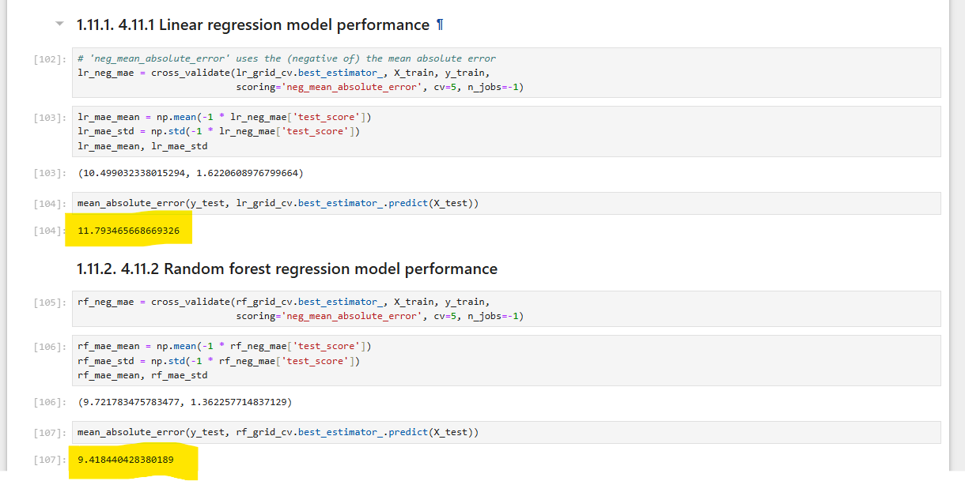
Modeling results and analysis
To predict the new ticket price, I used a method called the Random Forest model. Think of it like asking several experts for their opinions and then combining their responses to get the best possible answer
I measured the accuracy of this model using two evaluation methods: cross-validation and Mean Absolute Error (MAE). Cross-validation tested the data in five different forms to see how the model performed each time. MAE is like checking how far off our predictions were from the actual results on average, with a lower MAE indicating more accurate predictions.

Slide 6

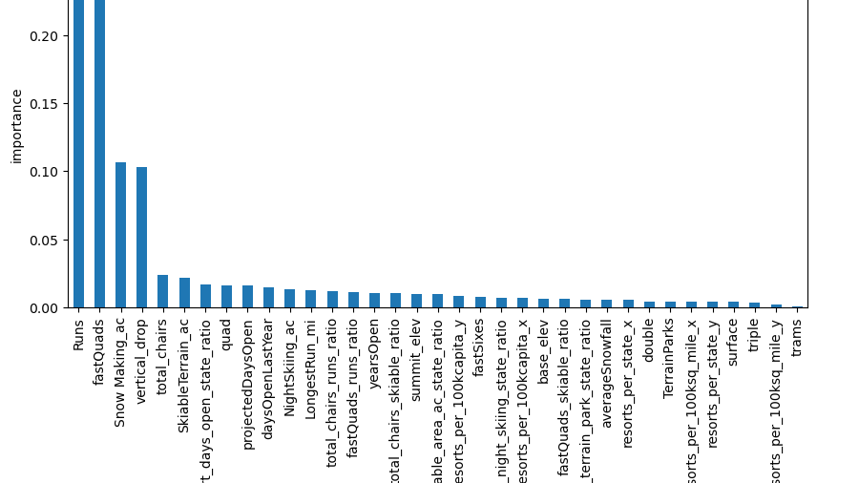
Best Features
One of the key functions of the Random Forest model is identifying the most important features in the data to accurately predict price increases.
The top features are Runs, Fast Quads, Snow Makers covered acres, and Vertical Drop.
Then there's a significant drop in importance for Total Chair Lifts and Skiable Terrain, then importance level drops a bit again and remains relatively constant for the remaining features.

Slide 7
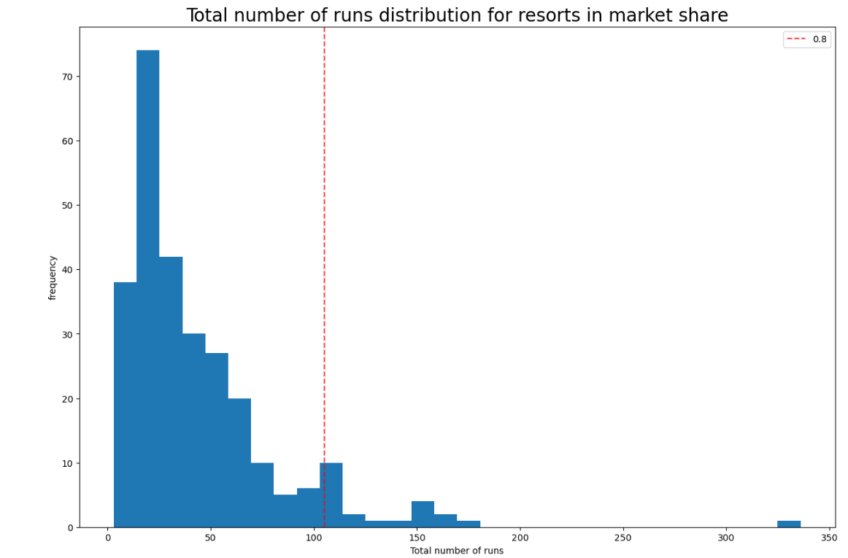
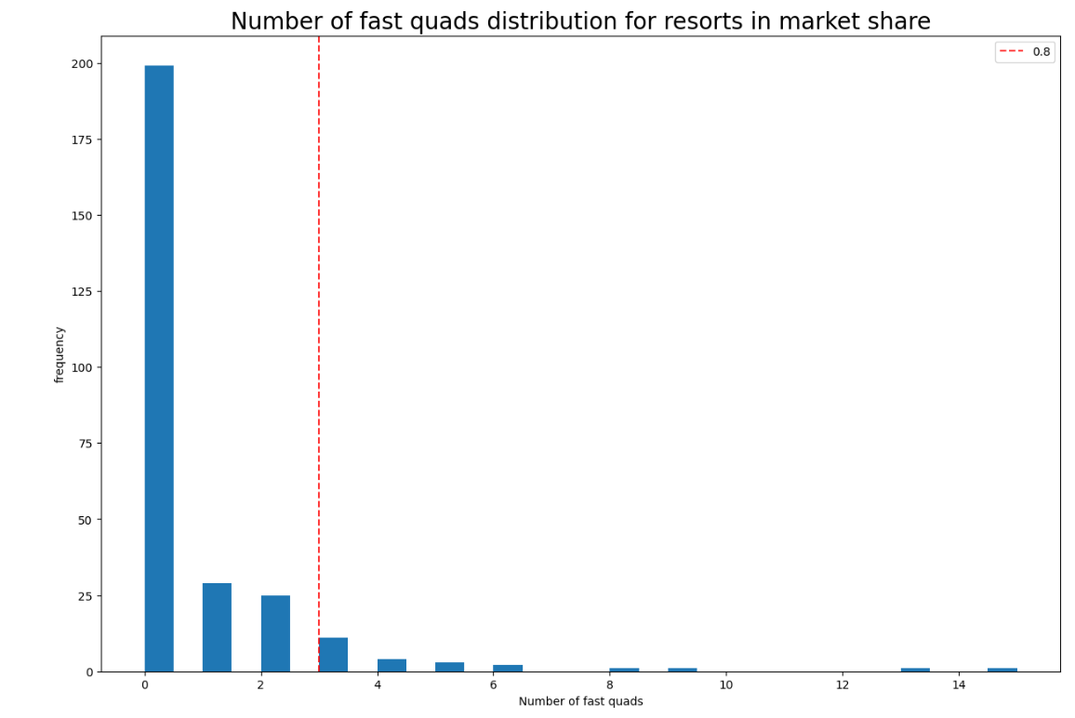
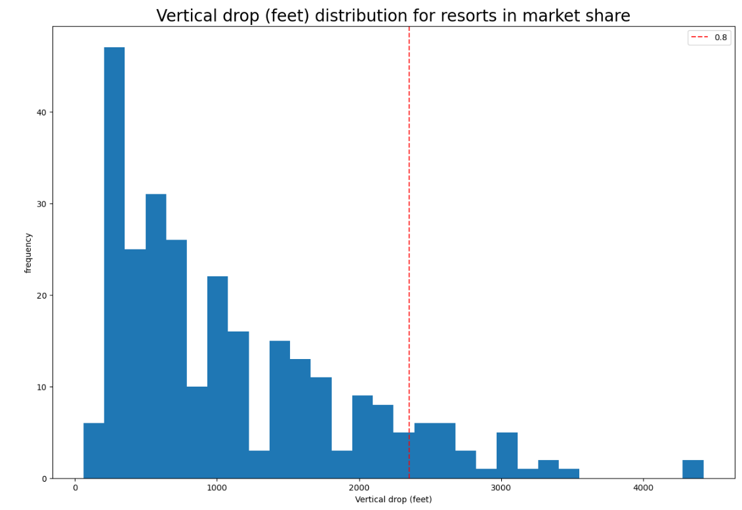
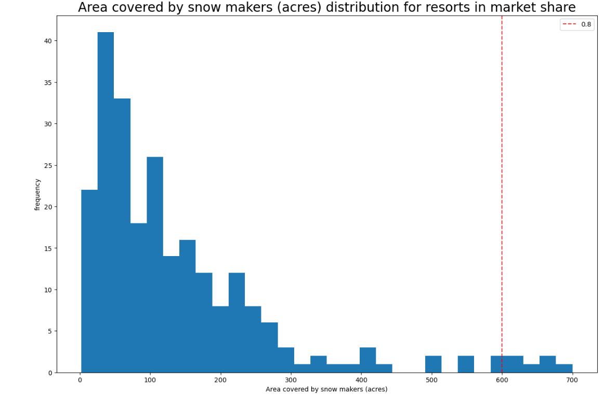
Big Mountain Resort excels in the four key areas of importance, ranking high on the list. This strong performance justifies considering a ticket price increase and confirming our suspicion of undercharging.
Big Mountain Resort

Slide 8
Conclusion
This machine learning algorithm and analysis consisted of the following stages:
Data Wrangling: Cleaning and organizing the data.
Exploratory Data Analysis: Understanding the data and identifying key patterns.
Preprocessing and Training: Preparing the data for modeling and training the model.
Modeling: Implementing and evaluating the Random Forest model.
At the end I concluded that the ticket price can be raised from $81 to anywhere from $87.60 to $108.32.

